Slide 1
Chapter 12: Random-Number Generators

Slide 2
Pseudo-Random-Number Generators
Algorithms called pseudo-random-number generators (PRNGs) are normally used in cryptography.
PRNGs algorithms can create long runs of numbers with good random properties, but eventually the sequence repeats.

Slide 3
Types of PRNG
There are three types of PRNGs:
Table look-up generators: Literally a table of precomputed pseudo-random numbers is compiled and numbers are extracted from it as needed.
Hardware generators: Some hardware process, perhaps packet loss on the network card or fluctuations from a chip, are used to produce pseudo-random numbers.
Algorithmic (software) generators: This is the type most commonly used in cryptography and the focus here.

Slide 4
Traits of a Good PRNG
Uncorrelated sequences: The sequences are not correlated. You cannot take a given stretch of numbers (say 16 bits) and use that to predict subsequent bits. There, quite literally, is no correlation between one section of output bits and another.
Long period: Ideally, the series of digits (usually bits) should never have any repeating patterns. However, the reality is that there will eventually be some repetition. The distance (in digits or bits) between repetitions is the period. The longer the period the better. Put another way: we accept that there will be repeated sequences, but those should be as far apart as possible.

Slide 5
Traits of a Good PRNG (continued)
Uniformity: Pseudo-random numbers are usually represented in binary format. There should be an equal number of 1’s and 0’s, though they need not be distributed in any discernable pattern. The sequence of random numbers should be uniform and unbiased. If you have significantly more (or significantly less) 1’s than 0’s, then the output is biased..
Computational indistinguishability: Any subsection of numbers taken from the output of a given PRNG should not be distinguishable from any other subset of numbers in polynomial time by any efficient procedure. The two sequences are indistinguishable. That does not, however, mean they are identical. It means there is no efficient way to determine specific differences.

Slide 6
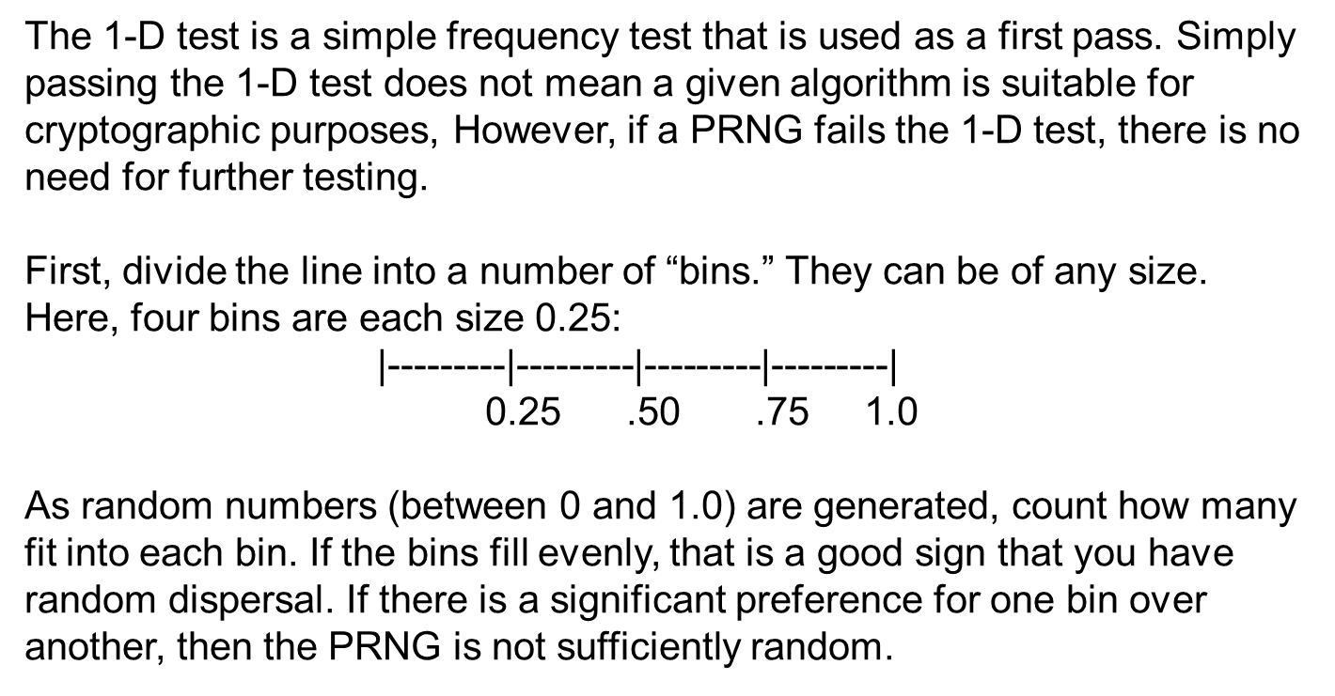
1-D Test

Slide 7
Equidistribution Test
This test is also sometimes called the Monobit frequency test.
This test seeks to verify that the arithmetic mean of the sequence approaches 0.5. This can be applied to the entire output of a PRNG or to a given segment.
Obviously, the larger the segment, the more meaningful the test.

Slide 8
Runs Test
A run is an uninterrupted sequence of identical bits.
The focus of this test is the total number of runs in the sequence.
A run of length k consists of exactly k identical bits and is bounded before and after with a bit of the opposite value.
The purpose of the runs test is to determine whether the number of runs of 1’s and 0’s of various lengths is as expected for a random sequence.
It determines whether the oscillation between such 1’s and 0’s is too fast or too slow.

Slide 9
Poker Test
The poker test for PRNGs is based on the frequency in which certain digits are repeated in a series of numbers.
It is best understood by considering a trivial example, a three-digit number. In a three-digit number, there are only three possibilities:
All three digits are the same.
The three digits are all different.
One digit is different from the other two.

Slide 10
Chi-Squared Test
The chi-squared test is a common statistical test often used to test a sampling distribution. It is used to compare observed data with data we would expect to obtain according to a specific hypothesis.
The application of this test to PRNGs is fairly straightforward.
Test results are usually reported as a chi² measure. A chi² measure of ±2 is probably random noise, ±3 probably means the generator is biased, and ±4 almost certainly means the generator is biased.
The lower the value, the more random the number sequence; the higher the value, the less random the number sequence.

Slide 11
PRNG Standards
The German Federal Office for Information Security (BSI) has established four criteria for quality of random number generators:
K1: A sequence of random numbers with a low probability of containing identical consecutive elements.
K2: A sequence of numbers that is indistinguishable from “true random” numbers according to specified statistical tests.
K3: It should be impossible for any attacker to calculate, or otherwise guess, from any given sub-sequence, or from any previous or future values in the sequence.
K4: It should be impossible for an attacker to calculate, or guess from an inner state of the generator, any previous numbers in the sequence or any previous inner generator states.

Slide 12
Middle-Square
This is a very old algorithm, first described by a Franciscan friar in the 13th century, and then reintroduced by John Von Neumann in the 1940s. It is a simple method and easy to follow. Here’s a step-by-step description:
1. Start with an initial seed (such as a four-digit integer).
2. Square the number. The middle four digits become the new seed.
3. Divide this value by 10,000 to produce the random number, and go back to step 2.
The following is a concrete example:
  1. x₀ = 1234
  2. x₁: 1234² = 01522756→ x₁ = 5227, R₁ = 0. 5227
  3. x₂: 5227² = 27321529→ x₂ = 3215, R₂ = 0.3215
  4. x₃: 3215² = 10336225→ x₃ = 3362, R₃ = 0.3362
The process is repeated indefinitely, generating a new random number each time. The middle four bits of each output is the seed for the next iteration of the algorithm.
This algorithm is not adequate for modern cryptographic purposes.

Slide 13
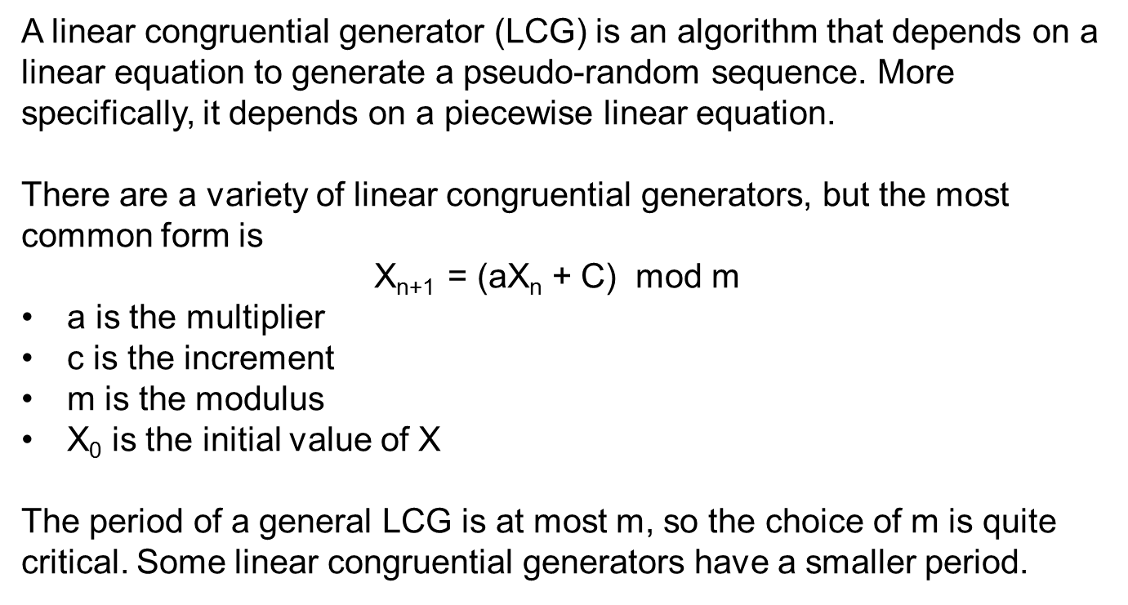
LCG

Slide 14
Lehmer Algorithm
This PRNG is named after D.H. Lehmer and is sometimes referred to as the Park-Miller random number generator, after S.K. Park and K.W. Miller.
This PRNG is of a class of PRNGs referred to as twisted generalized feedback shift registers.
It is the classic example of a linear congruential generator.

Slide 15
Mersenne Twister
The original version is not suitable for cryptographic purposes but permutations of it are.
This PRNG was invented by Makoto Matsumoto and Takuji Nishimura.
It has a very large period, 2¹⁹⁹³⁷−1, which is greater than the many other generators.
The most commonly used version of the Mersenne Twister algorithm is based on the Mersenne prime 2¹⁹⁹³⁷−1 and uses a 32-bit word. It is often called MT 19937. There is a 64-bit word version called MT 199937-64.

Slide 16
Blum Blum Shub
This algorithm was proposed in 1986 by Lenore Blum, Manuel Blum, and Michael Shub. The format is as follows:
  X_{n+1} = X_{n}² Mod M
M=pq is the product of two large primes p and q (this should remind you of the RSA algorithm). At each step of the algorithm, some output is derived from Xn+1.
The main difficulty of predicting the output of Blum Blum Shub lies in the difficulty of “quadratic residuosity problem.” That mathematical problem, put simply, is this: given a composite number n, find whether x is a perfect square modulo n.
It has been proven that this is as difficult as breaking the RSA public-key cryptosystem, which involves the factoring of a large composite. This makes Blum Blum Shub a quite effective PRNG.

Slide 17
Yarrow
This algorithm was invented by Bruce Schneier, John Kelsey, and Niels Ferguson.
Yarrow is no longer recommended by its inventors and has been supplanted by Fortuna.
The general structure of Yarrow is relatively simple to understand. It has four parts:
An entropy accumulator: Collects semi-random samples from various sources and accumulates them in two pools.
A generation mechanism: Generates the PRNG outputs.
Reseed mechanism: Reseeds the key periodically with new entries from the entropy pools.
Reseed control: Determines when reseeding should occur.

Slide 18
Fortuna
Fortuna is a group of PRNGs and has many options for whoever implements the algorithm.
It has three main components (not this is quite similar to Yarrow):
A generator, which is seeded and will produce pseudo-random data
The entropy accumulator that collects random data from various sources and uses that to reseed the generator
The seed file, which has initial seed values

Slide 19
Dual_EC_DRBG
Dual Elliptic Curve Deterministic Random Bit Generator became well known outside of cryptographic circles when Edward Snowden revealed that the algorithm contained a backdoor inserted by the National Security Agency.
The algorithm itself is based on elliptic curve mathematics and was standardized in NIST SP 800-90A.
According to John Kelsey, the possibility of the backdoor by carefully chosen P and Q values was brought up at a meeting of the ANSI X9.82 committee. As a result, a way was specified for implementers to choose their own P and Q values.

Slide 20
Marsaglia CD-ROM
Tables of pseudo-random numbers can be used as sources for random numbers.
George Marsaglia produced a CD-ROM containing 600 megabytes of random numbers. These numbers were produced using various dependable PRNGs but were then combined with bytes from a variety of random sources, or semi-random sources, to produce quality random numbers.

